Slide 1

Team Name : GlobalPath AI
Team Leader Name : Vaishak Harikumar
Problem Statement : AI for Communities, Access & Public Impact

Slide 2

Brief about the Idea: GlobalPath AI – Your Personalized Bureaucracy Navigator for Immigrants & International Students
There's overwhelming and country-specific bureaucratic red tape in visas, healthcare enrollment, housing rights/eligibility, and tax requirements for immigrants and international students. This results in delays, penalties, denials, opportunities missed, and increased stress levels, particularly for master's students adjusting to new countries.
GlobalPath AI: An AI-driven local policy guidance tool that allows users to upload official documents (acceptance letters, visa notices, healthcare forms, tax letters) and immediately obtain personalized, step-by-step action plans in everyday language. The AI parses complex legal/administrative documents and cross-references official sources to offer suggestions and deadlines, along with trusted resource recommendations (e.g., Mastersportal.com for study programs, EducationUSA.gov for visas to the USA, embassy sites worldwide).
Initial focus on high-impact countries (e.g., India for incoming students, then the USA, Canada, Germany, UK, Australia), emphasizing equity: multilingual support, non-native speaker accessibility, and free basic guidance to minimize barriers in public systems.

Slide 3
How different is it from any of the other existing ideas?
Most existing tools are:
Immigration-only (e.g., visa checkers like VFS Global apps or JustiGuide – U.S.-centric)
Fragmented (separate apps for housing like Nestpick, tax like TurboTax, healthcare portals)
Employer-focused (Deel, Jobbatical) or general chatbots (ChatGPT hacks) that hallucinate or lack document parsing
GlobalPath AI stands out by:
Integrating the full post-arrival stack (visa + healthcare + housing + tax) in one tool
Using document upload + AI parsing for personalized, accurate plans (not generic advice)
Targeting international students/migrants specifically with education-focused resources (e.g., scholarship sites, uni housing portals)
Emphasizing public impact: democratizing access to scattered government/NGO resources for underserved global communities

Slide 4
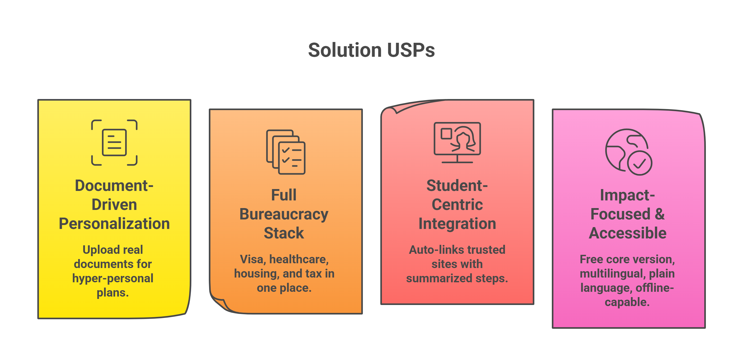
USP of the proposed solution

Slide 5
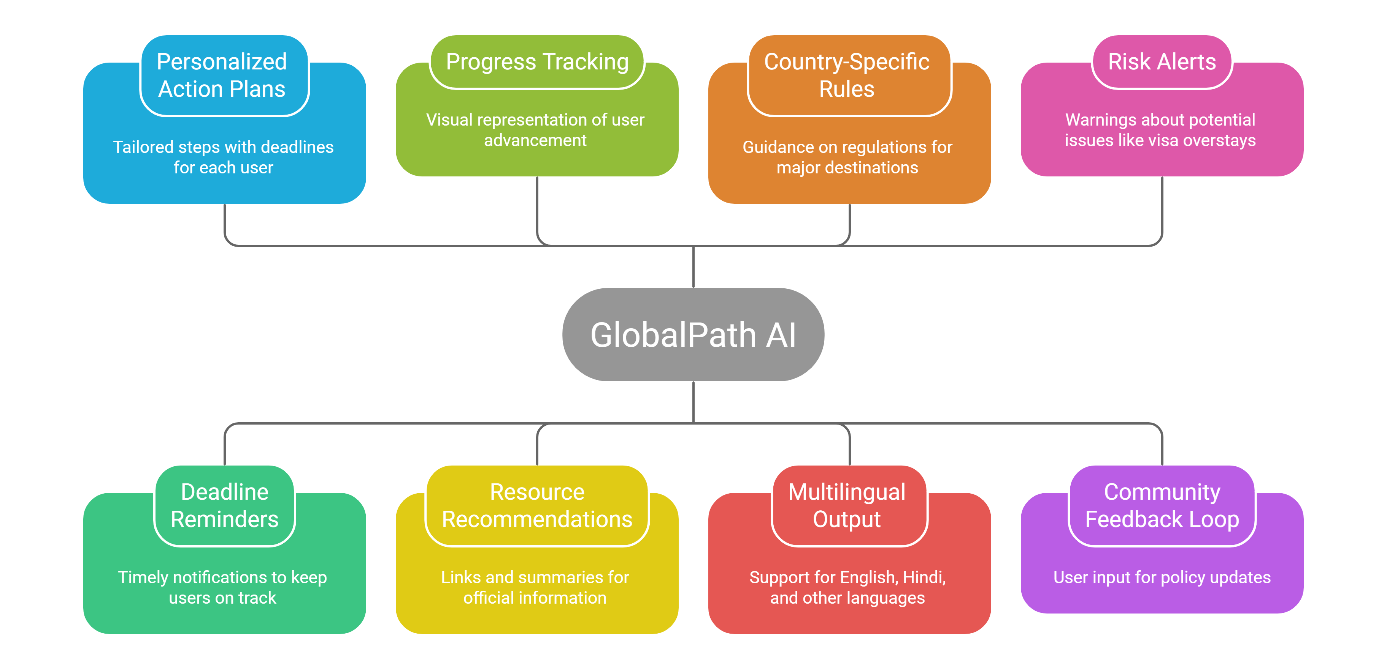
List of features offered by the solution

Slide 6
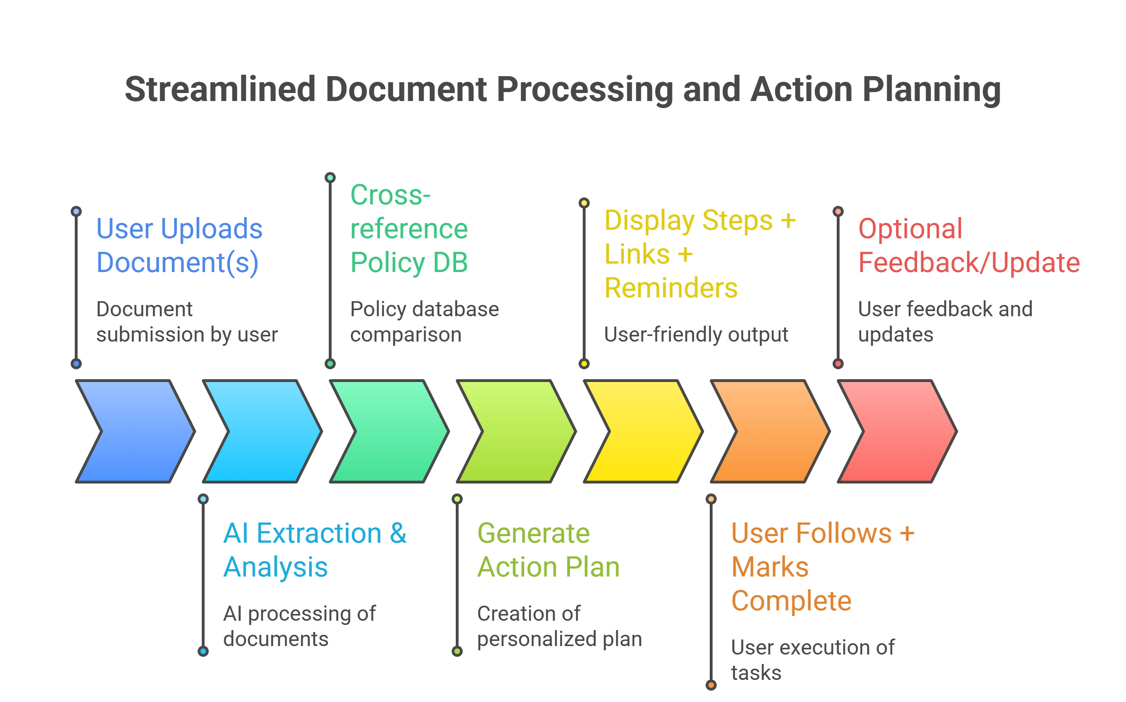
Process flow diagram
Solves root issue: information asymmetry and complexity in public systems → empowers communities with equitable access.

Slide 7
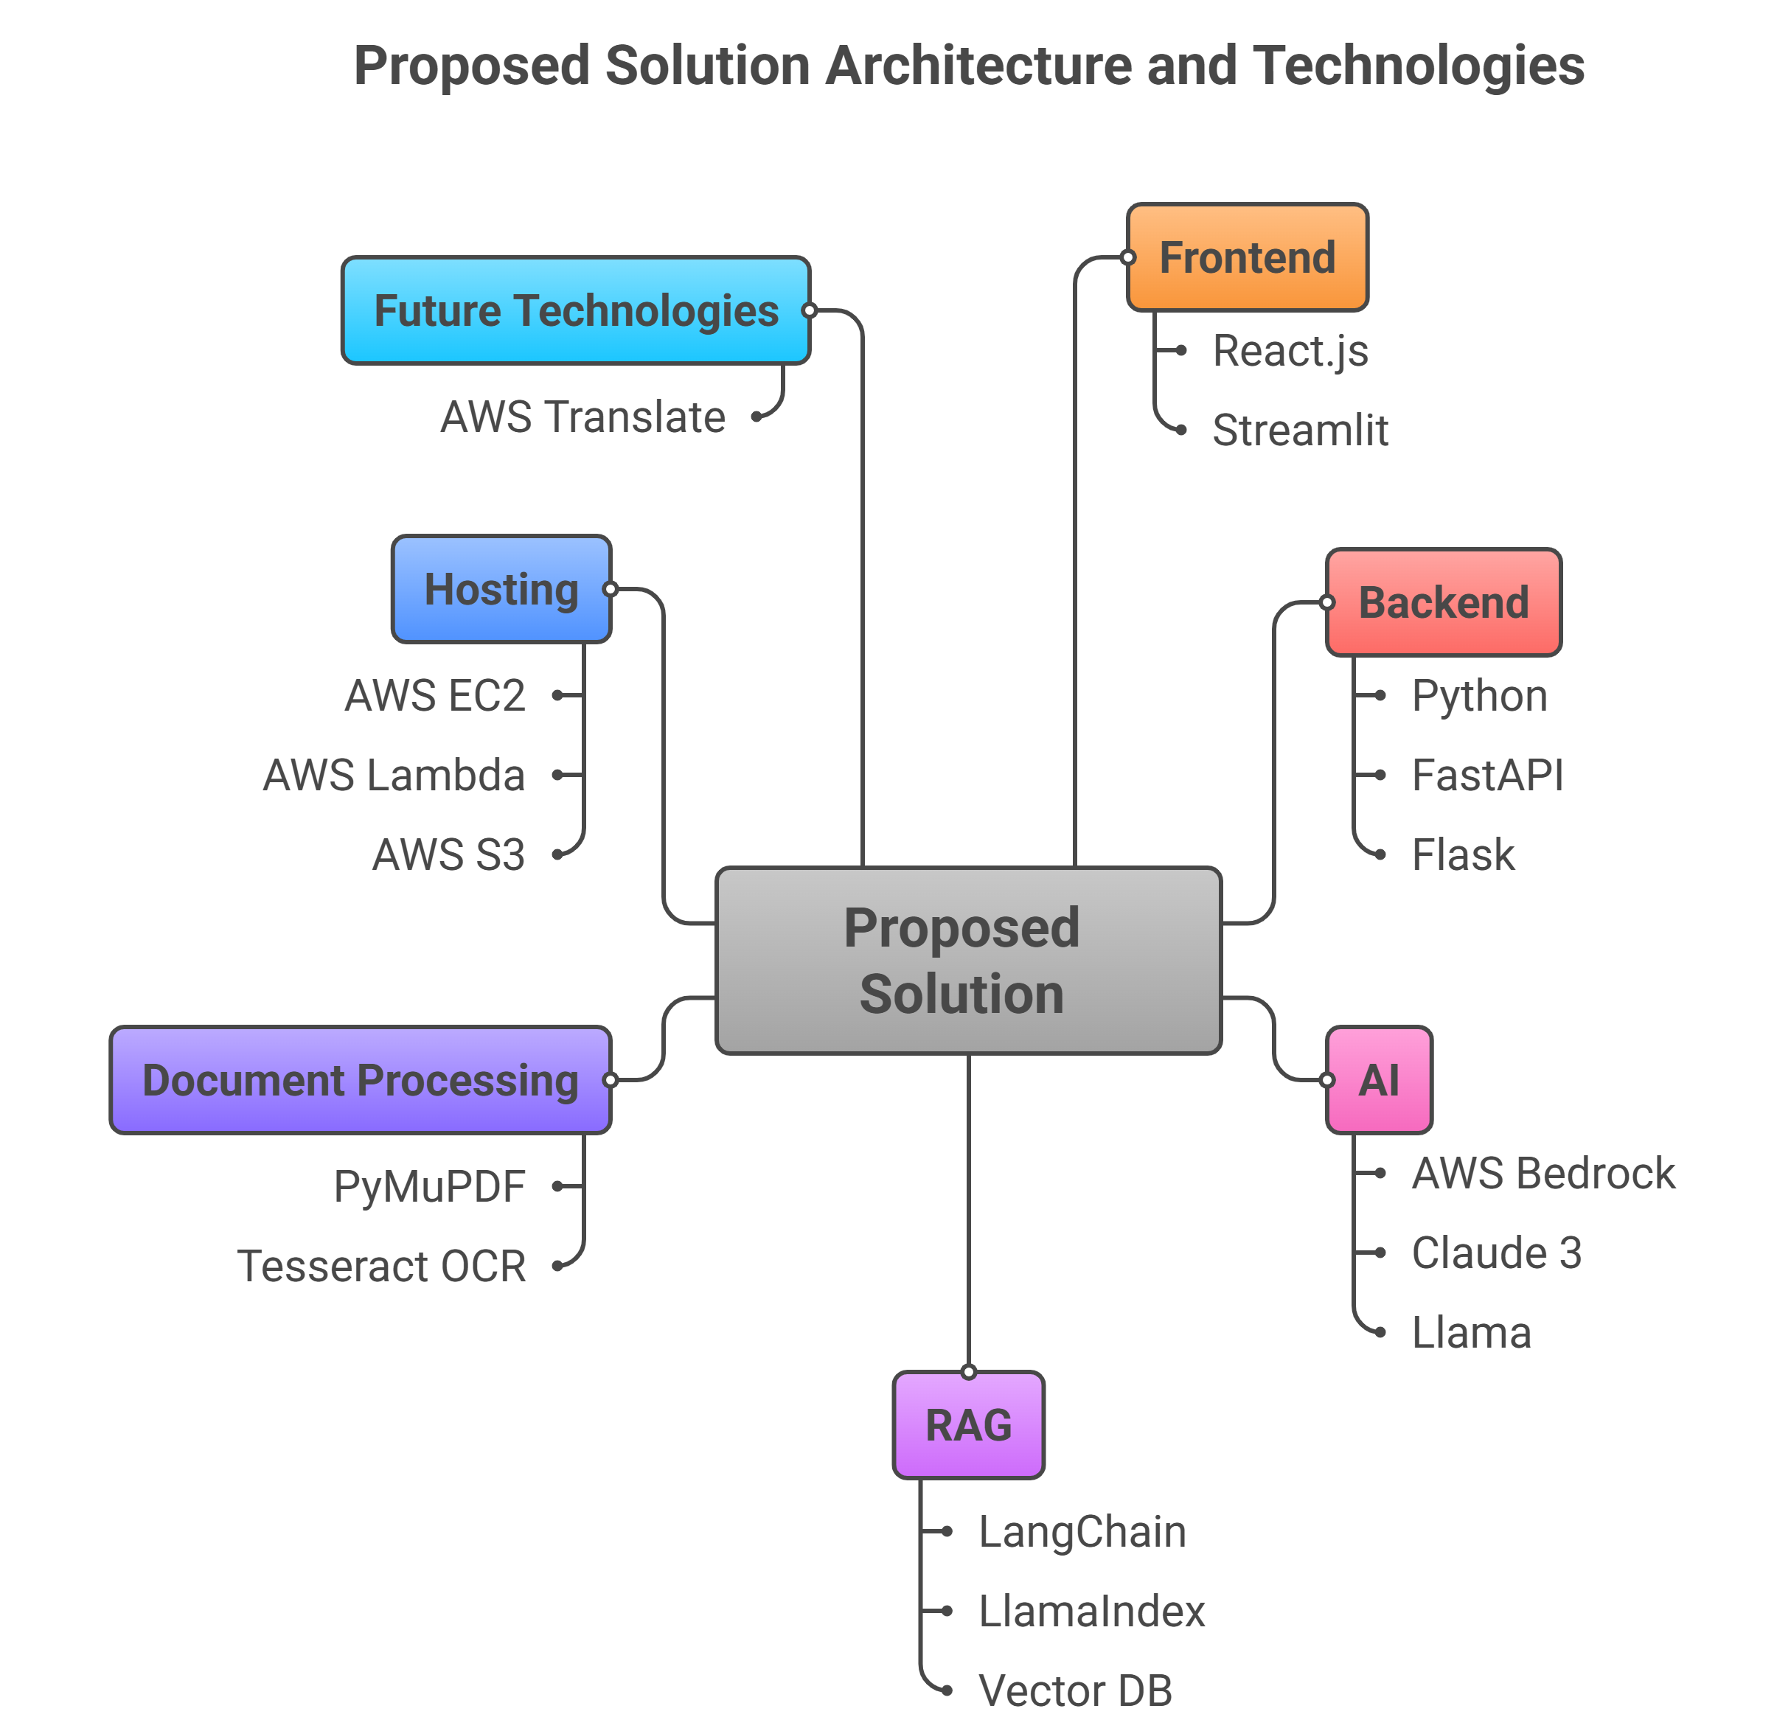
Architecture diagram of the proposed solution:

Slide 8
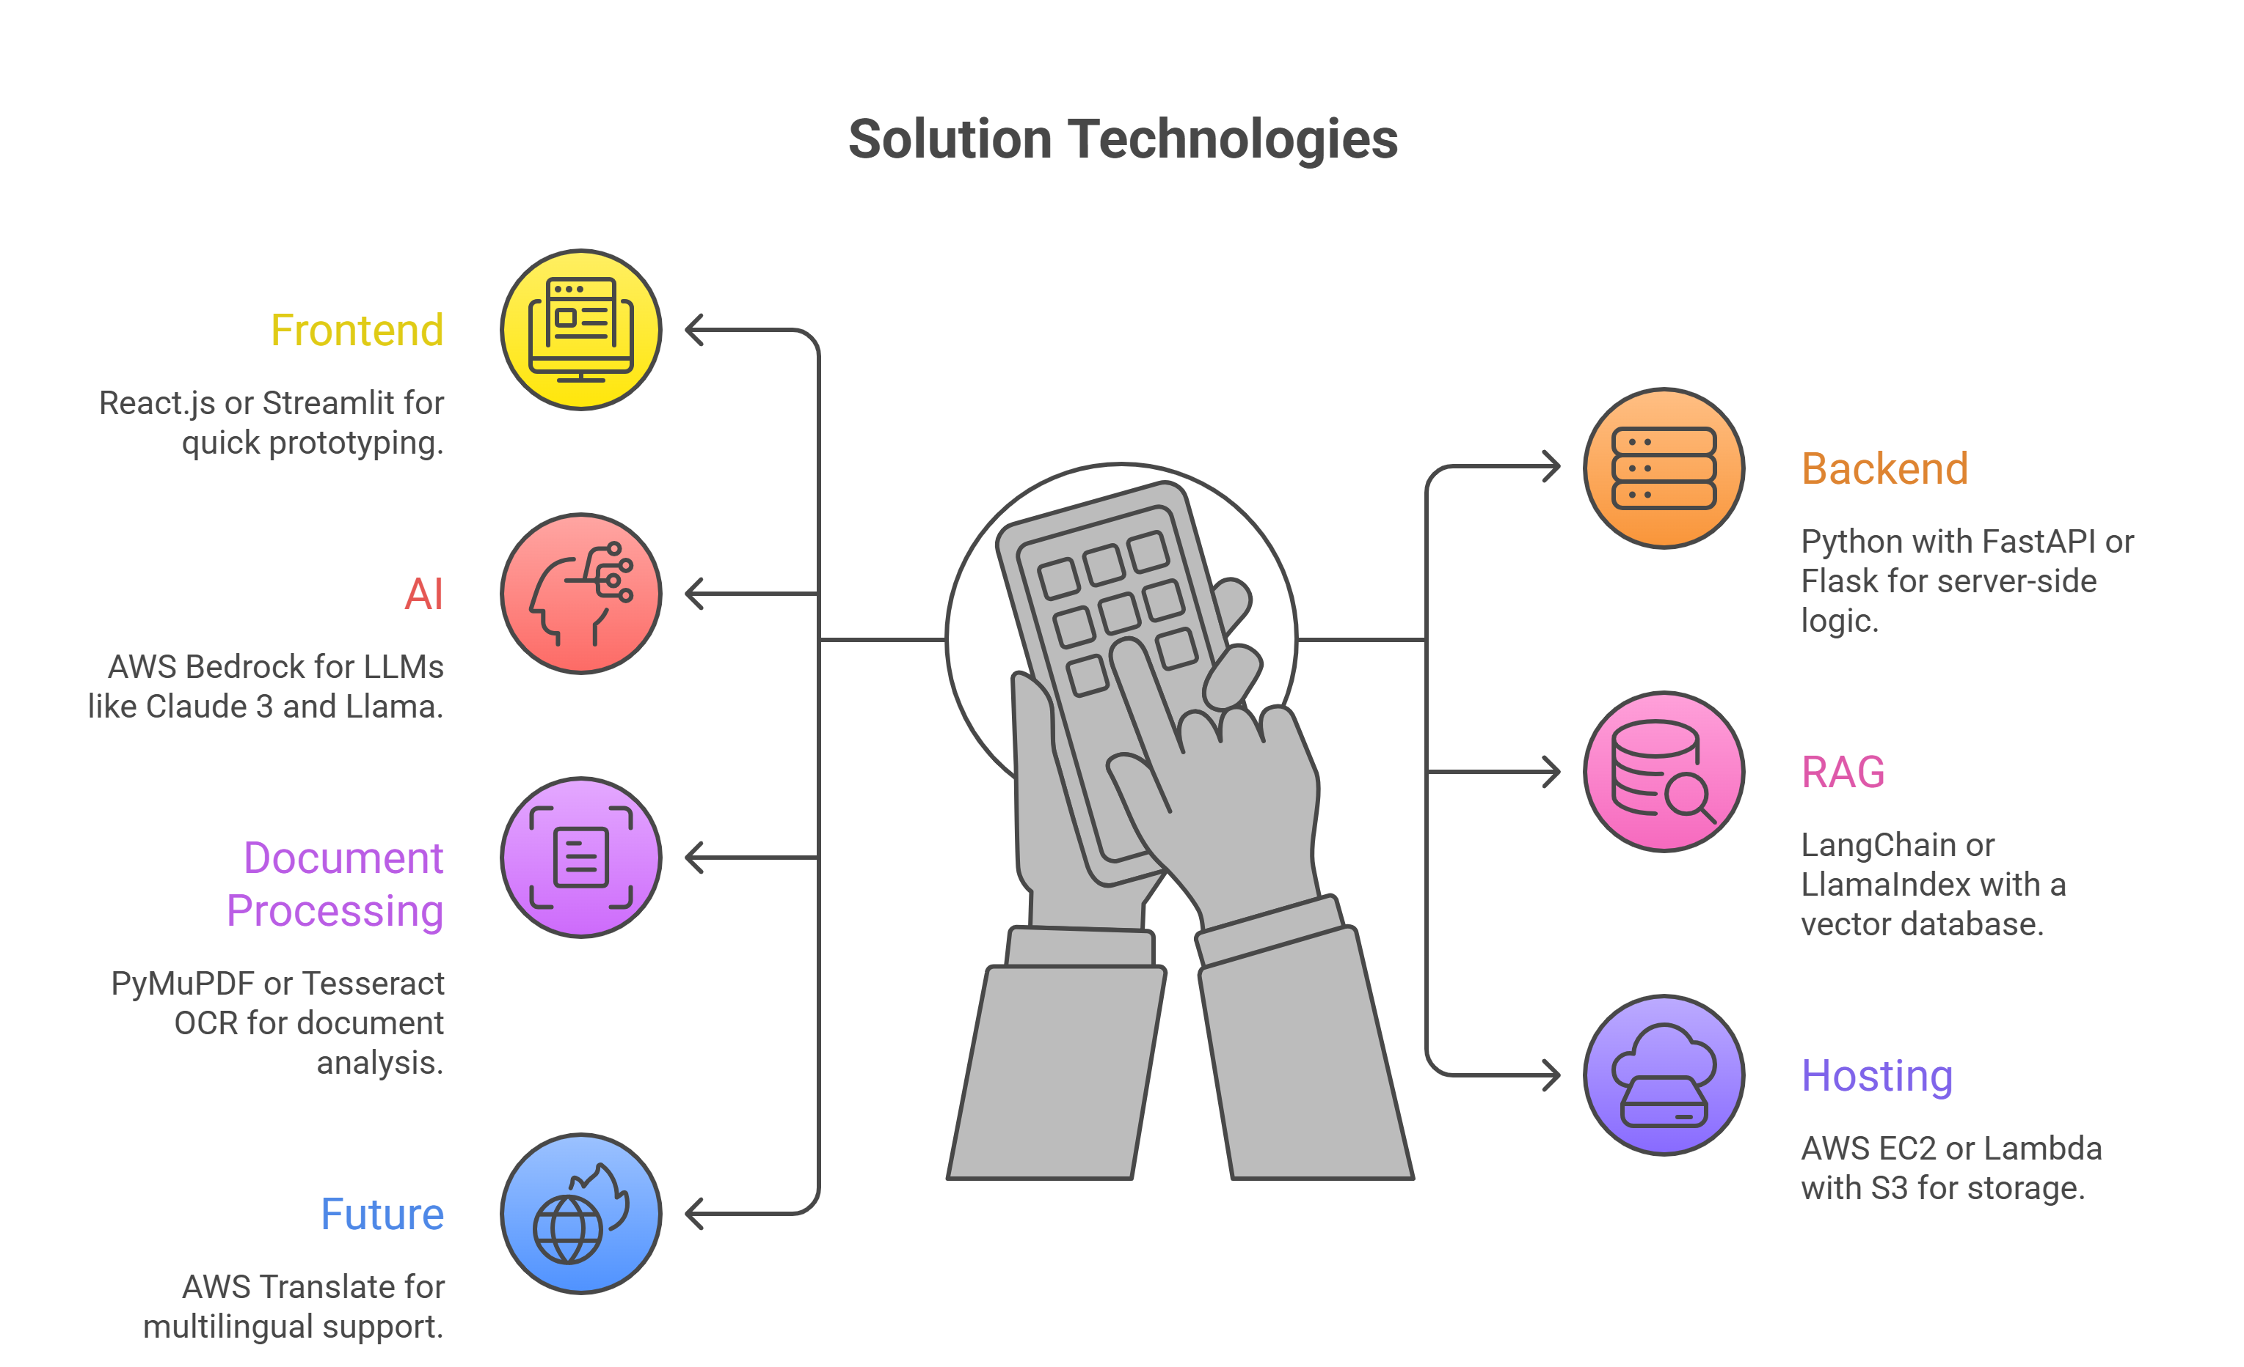
Technologies to be used in the solution:

Slide 9
Estimated implementation cost:
MVP (idea to prototype): ~₹50,000–1,00,000 (mostly AWS credits from hackathon + free tiers)
Development: Student team time (low cost)
AWS: Credits cover Bedrock/Lambda/S3
Scaling later: Subscription model + premium features

Slide 10


